Slide 1

Data Science Problem
Visualization &
Prediction
CZ1015 DSAI Mini Project
FS6T06
KIM HEONJUNG / LEOW GUAN WEI MALCOLM PANG QING HAN / SIOW KEE TAT, KEITH

Slide 2



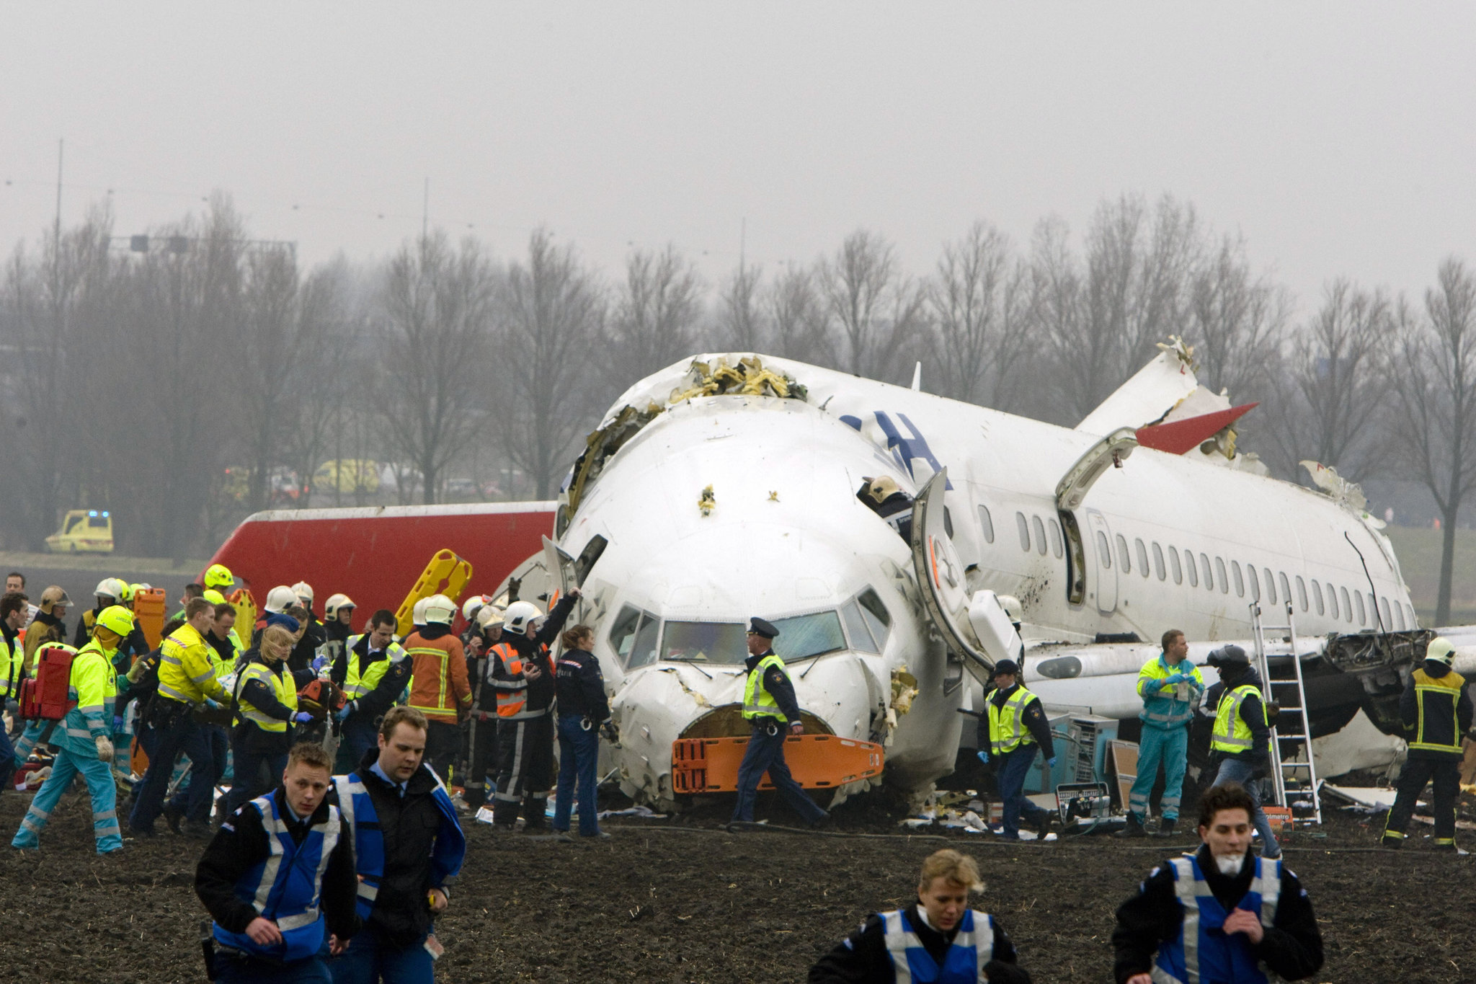
Problem
“ How can we improve the
safety of an aircraft? ”

Slide 3



Process
Choose Dataset
Aviation Accident Dataset
Visualization & Data Cleaning
Explore data and prepare cleaned data for the prediction
Prediction
Use Machine Learning Model
Notes:
Mention which dataset we worked on : Dataset 4 - Aviation Accident Dataset
Our objective

Slide 4





Data Analysis
Injury Severity
Total Injuries
Aircraft Damage
Country
Latitude / Longitude
Location
Damage
Aviation Accident
Aircraft
Weather
Aircraft Category
Engine Type
Event Id
Weather Condition

Slide 5
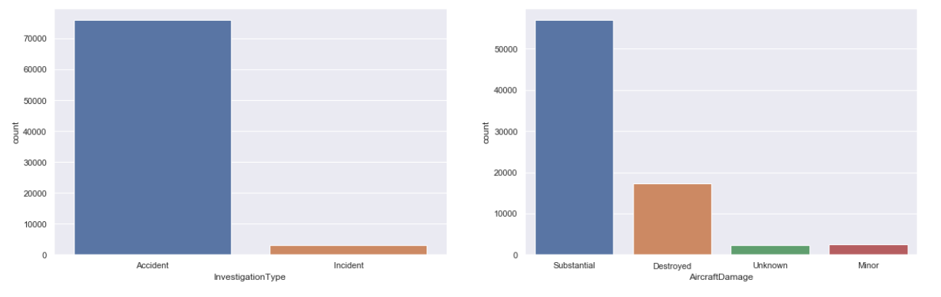
Visualization
Investigation Type
Aircraft Damage

Slide 6
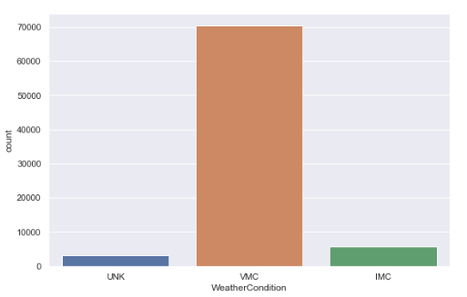
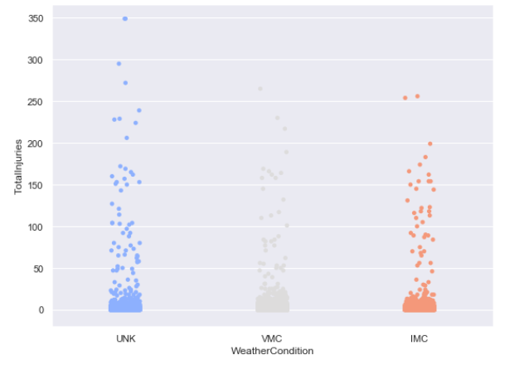
Visualization
unknown
visual flight is permitted
Weather Condition
require flight by reference to instruments
UNK
VMC
IMC
Notes:
VMC - aviation flight category that visual flight rules (VFR) flight is permitted
IMC - aviation flight category that describes weather conditions that require pilots to fly primarily by reference to instruments

Slide 7
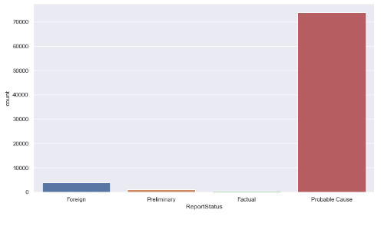
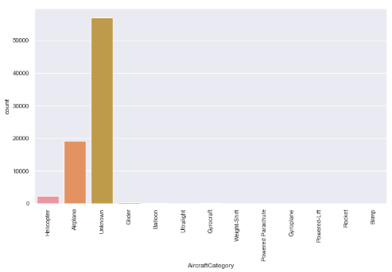
Visualization
Report Status and Aircraft Category

Slide 8
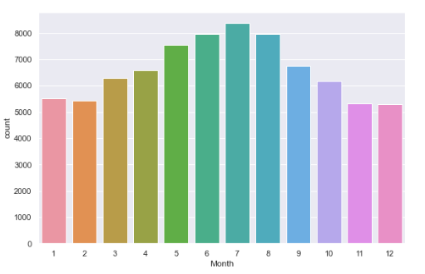
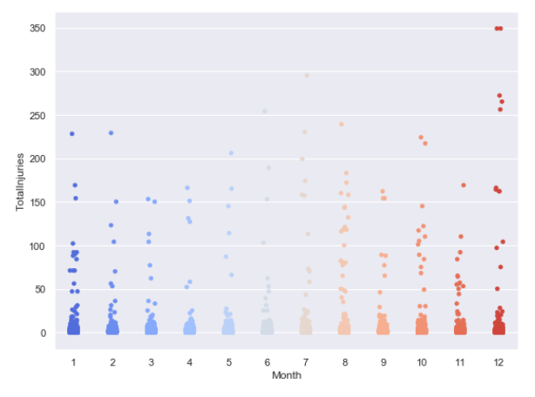
Visualization
Month

Slide 9
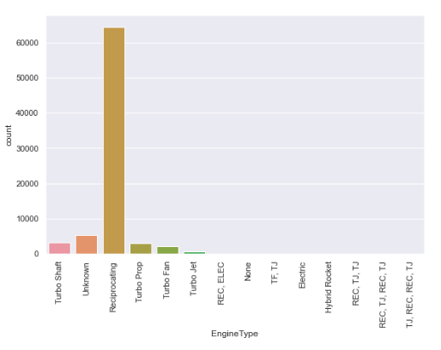
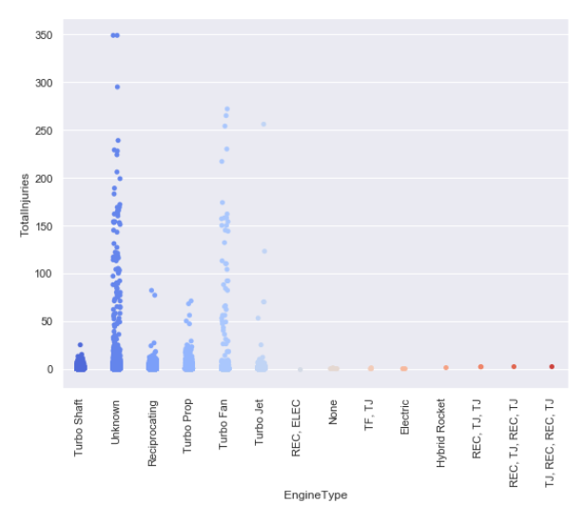
Visualization
Engine Type

Slide 10
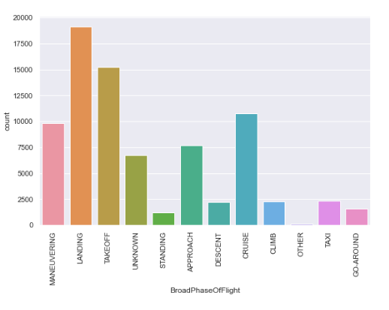
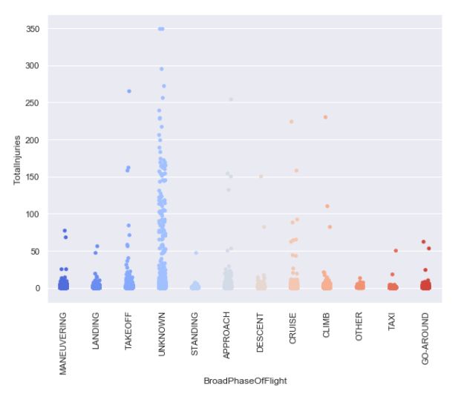
Visualization
Broad Phase of Flight

Slide 11
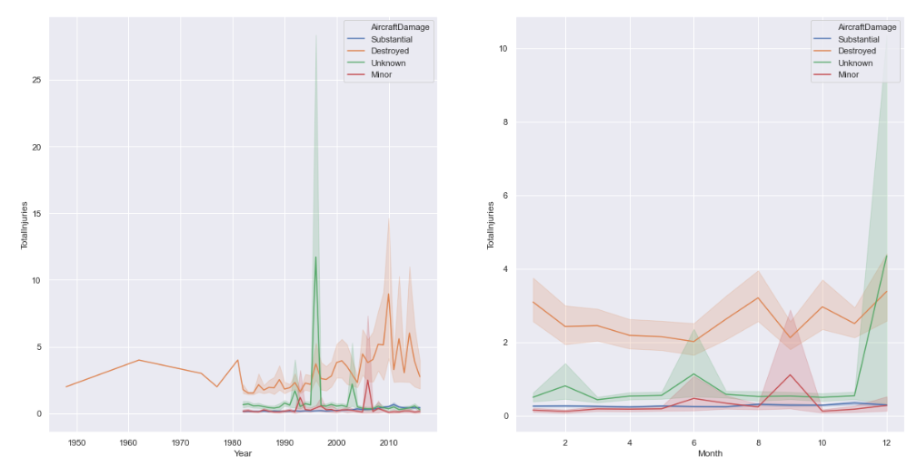
Visualization
Total Injuries over time

Slide 12
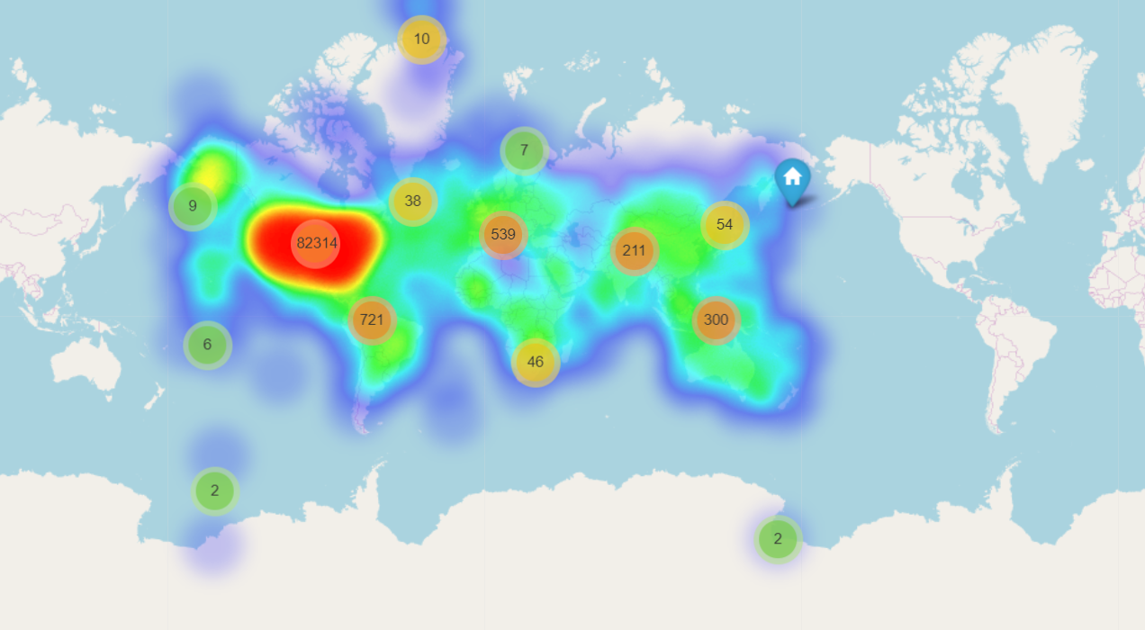
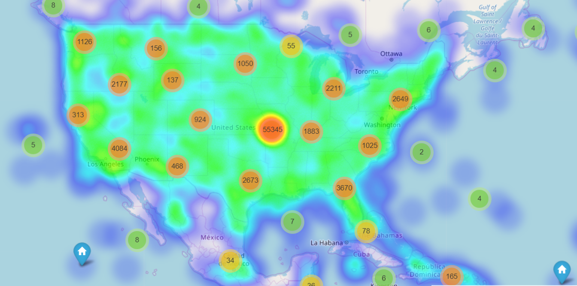
Visualization
Total Fatal Injuries by Location

Slide 13
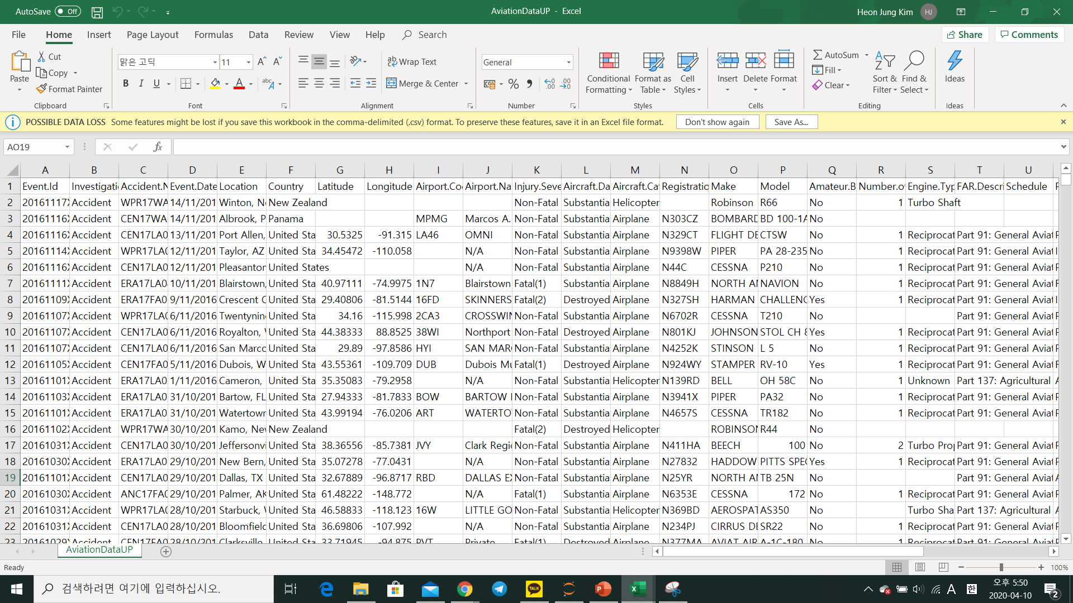
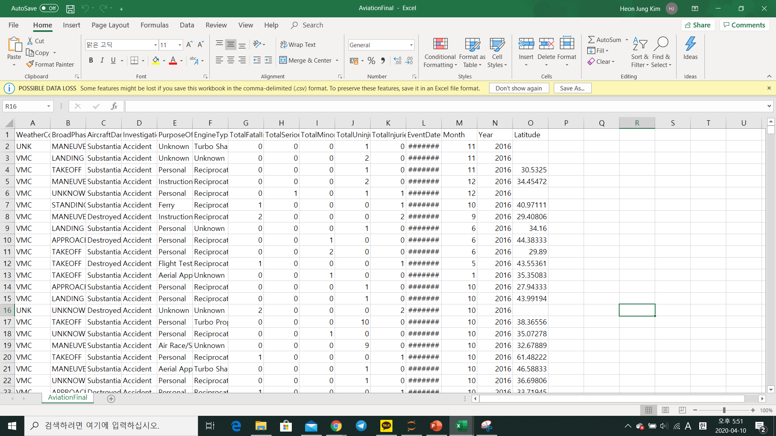
Data Cleaning
Readability
rename all columns
fill in null columns
Selected columns with ‘Unknown’
or 0 / Others by imputing
Reorganized
created new columns
year and month by extracting date
‘TotalInjuries’ by adding together
all injuries
extracted & converted
objects to Categorical data
created new dataset
exported to new CSV
Export
Notes:
Can be slide s

Slide 14
Machine Learning
Predict Aircraft Damage
WeatherCondition, BroadPhaseOfFlight, PurposeOfFlight, EngineType, Month, AircraftCategory, NumberOfEngines, ReportStatus
Classification models

Slide 15
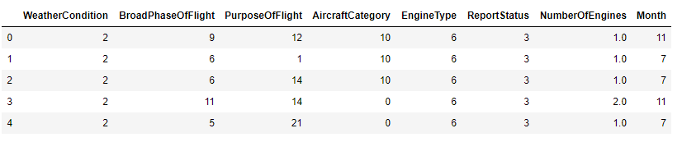
Machine Learning
Convert Categorical Columns to Numerical
Using label encoder, new columns:

Slide 16
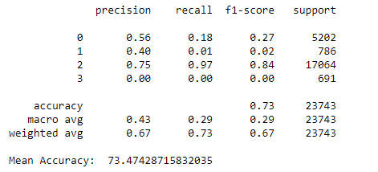
Machine Learning
Logistic Regression with Recursive Feature Elimination
Fitting it into the logistic regression model

Slide 17
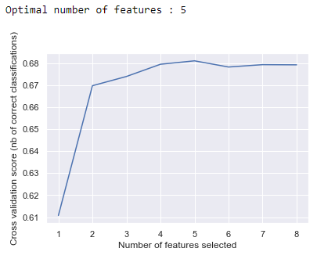
Machine Learning
Logistic Regression with Recursive Feature Elimination
5 features is optimal out of the 8
Important Features:

Slide 18
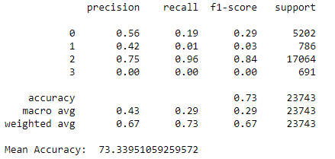
Machine Learning
Logistic Regression with Recursive Feature Elimination
Accuracy decreased slightly,
from 73.4% to 73.3%

Slide 19
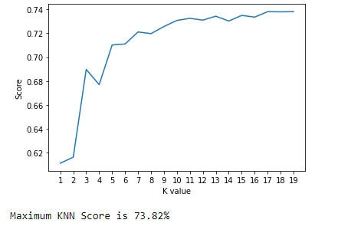
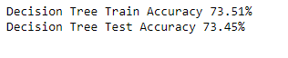
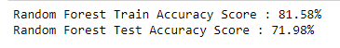
Machine Learning
K-Nearest Neighbours
Decision Tree Classifier
Random Forest Classifier

Slide 20
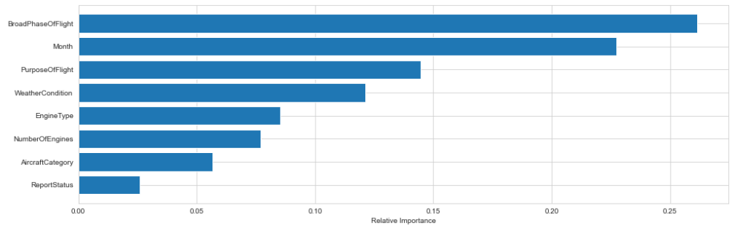
Machine Learning
Feature Importance

Slide 21
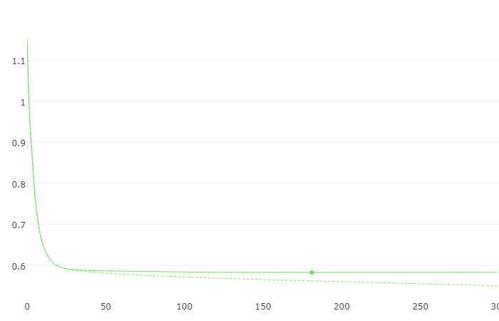
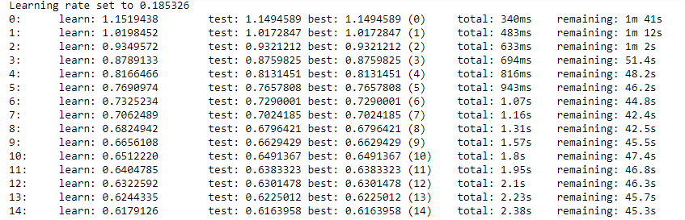
Machine Learning
Catboost Classifier
categorical features to convert Categorical to Numerical
WeatherCondition, BroadPhaseOfFlight, PurposeOfFlight, EngineType, AircraftDamage
Notes:
high performance Gradient Boosting on Decision Trees library, used for ranking, classification, regression and other machine learning tasks

Slide 22
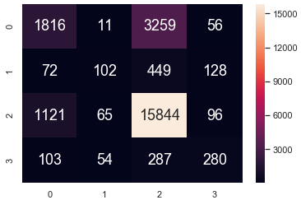
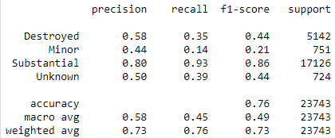
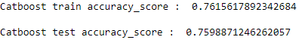
Machine Learning
Catboost Classifier
categorical features to convert Categorical to Numerical
WeatherCondition, BroadPhaseOfFlight, PurposeOfFlight, EngineType, AircraftDamage
Notes:
high performance Gradient Boosting on Decision Trees library, used for ranking, classification, regression and other machine learning tasks

Slide 23
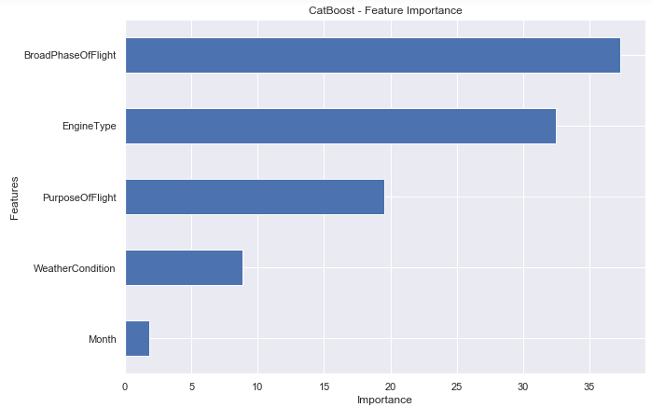
Machine Learning
Catboost Feature Importance
categorical features to convert Categorical to Numerical
WeatherCondition, BroadPhaseOfFlight, PurposeOfFlight, EngineType, AircraftDamage
Notes:
Catboost is built with a similar approach and attributes as with the “older” generation of GBDT models.
Catboost’s power lies in its categorical features preprocessing, prediction time and model analysis.
Catboost’s weaknesses are its training and optimization times.
Don’t forget to pass cat_features argument to the classifier object. You aren’t really utilizing the power of Catboost without it.
Though Catboost performs well with default parameters, there are several parameters that drive a significant improvement in results when tuned.

Slide 24
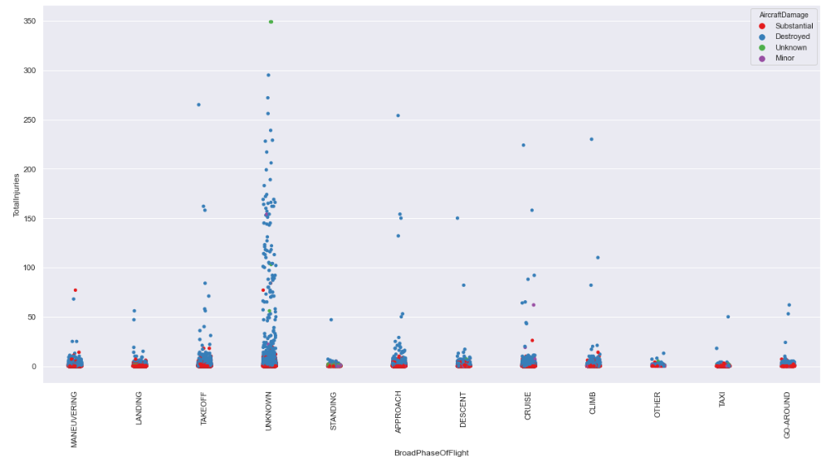
Conclusion

Slide 25
Conclusion
Learning Pointers
Data Handling
Exposure to new libraries
Usage of different Models and Parameters.

Slide 26
Conclusion
What to Improve on
Exploration of Unsupervised learning methods e.g anomaly detection
Further exploration

Slide 27
Individual Contributions
Task | Group Member
Data Cleaning | Leow Guan Wei
Exploratory Analysis & Visualization | Malcolm Pang Qing Han, Kim HeonJung, Leow Guan Wei, Siow Kee Tat, Keith
Machine Learning
Logistic Regression | Leow Guan Wei
K-Nearest Neighbours, Decision Tree Classifier, Random Forest Classifier | Malcolm Pang Qing Han
Catboost | Siow Kee Tat, Keith
Slides | Kim HeonJung

Slide 28
References
https://towardsdatascience.com/encoding-categorical-features-21a2651a065c (encoding categorical values)
https://scikit-learn.org/stable/modules/generated/sklearn.linear_model.LogisticRegression.html (logistic regression)
https://towardsdatascience.com/an-implementation-and-explanation-of-the-random-forest-in-python-77bf308a9b76 (random forest)
https://towardsdatascience.com/data-101s-spatial-visualizations-and-analysis-in-python-with-folium-39730da2adf (folium map)
https://towardsdatascience.com/catboost-vs-light-gbm-vs-xgboost-5f93620723db (Catboost)
https://catboost.ai/docs/concepts/python-reference_catboostclassifier.html (Catboost)

Slide 29
THANK YOU
CZ1015 FS6T06 Mini Project

Slide 30
Q&A
:-)

